Slide 1
Dying To Be A Mom
The Impact of Race and Bias on Maternal Health
Carla Ortique, MD
The Women's Specialists of Houston At Texas Children's Hospital Pavilion for Women
TMA Maternal Health Congress
March 24, 2018
Notes:
*Font may be decreased to 32 point should two lines be present inside the headline field.

Slide 2
Objectives
Review statistics regarding racial disparity in Maternal Mortality
Consider potential causes for racial disparities in Maternal Mortality and Severe Morbidity
Review definitions of basic terminology pertaining to cultural awareness and education
Increase sensitivity and awareness of racial healthcare disparities
Create interest in the study and elimination of racial healthcare disparities

Slide 3

“Women are not dying because the diseases cannot be prevented but because societies have not decided their lives are worth saving.” Professor Fathalla, Past President International Federation of Obstetrics and Gynecology to the UN 2006

Slide 4
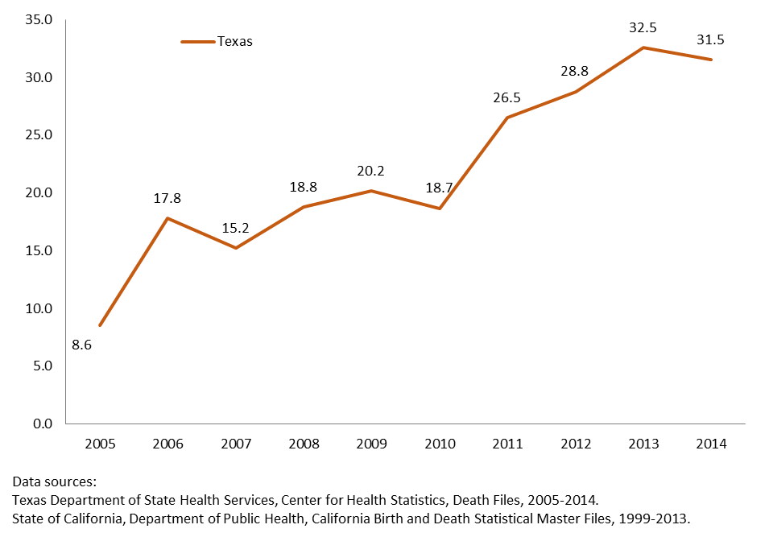
Texas Maternal Mortality
Notes:
SLIDE 3
This is the Texas maternal mortality rate or MMR using death certificate data and the standard definition.
The standard definition of maternal mortality is death during pregnancy or within 42 days following the end of the pregnancy.
_____________
JUST FOR YOUR INFORMATION
We continue to learn from recently published articles that maternal deaths identified using only death certificate data is quite imprecise and can lead to inflated estimates of maternal mortality.
Error may be due to incorrect pregnancy status and cause of death information on the death certificate.
However, there are several efforts that DSHS is undertaking to improve the accuracy of its death certificates, as highlighted in a recent TMA feature article.

Slide 5
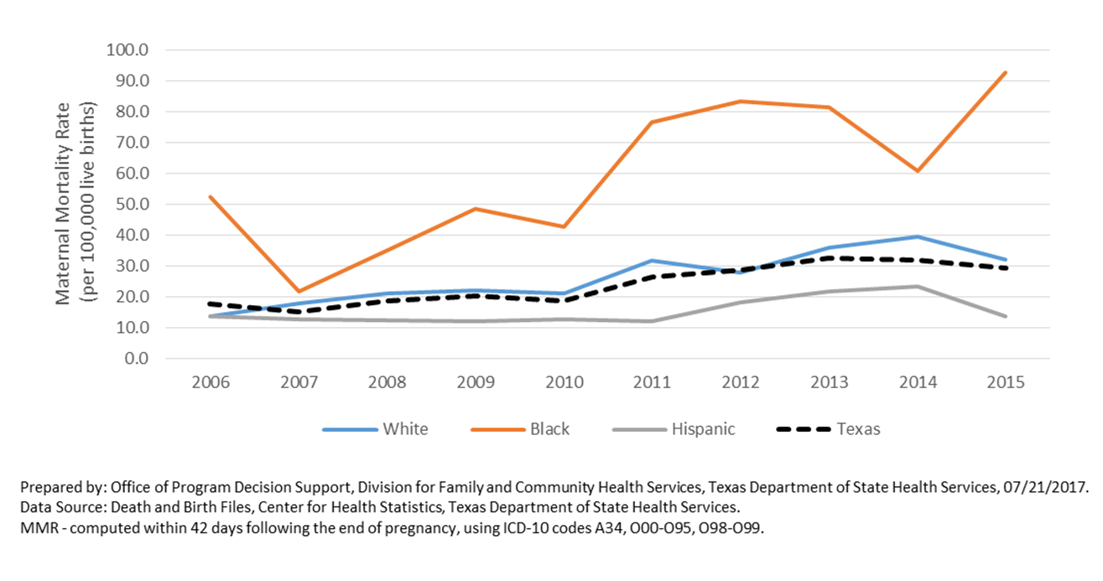
Texas Maternal Mortality by Racial/Ethnic Group
Notes:
SLIDE 4
Similar to national trends, the maternal mortality rate in Texas is highest among Black women, and the disparity between African American women and all others has been increasing over time.

Slide 6
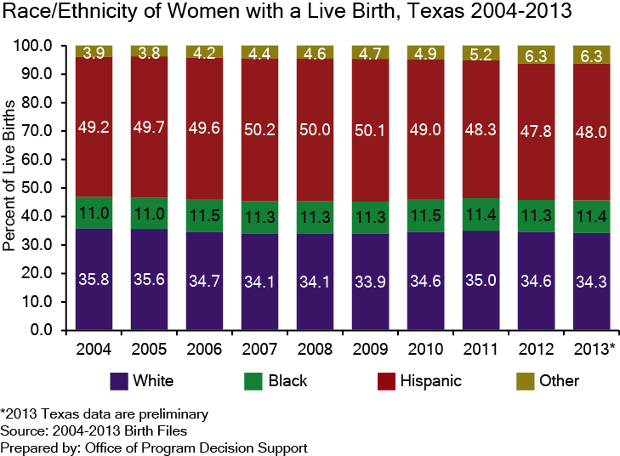
Demographic Shift:
Race/Ethnicity of Mothers
Races in the “Other” category have increased their percentage of births in the past 10 years
  In 2013, 25.5% of women in the “Other” category were Indian and 12.5% were Vietnamese
Blacks have maintained a steady proportion of resident births in Texas since 2006

Slide 7
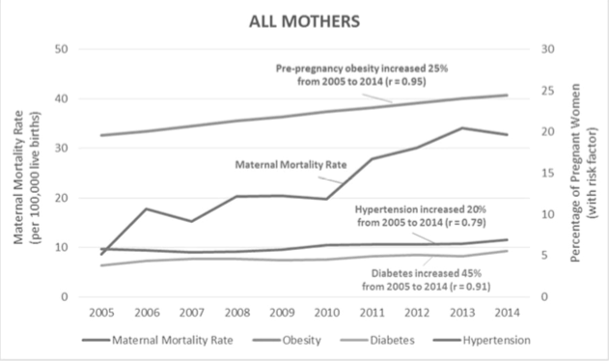
Prepared by: Office of Program Decision Support, Division for Family and Community Health Services, Texas Department of State Health Services, 08/24/2016. Data Sources: Death and Birth Files, Center for Health Statistics, Texas Department of State Health Services. MMR — computed within 42 days following the end of pregnancy, using ICD‐10 codes A34, O00‐095, O98‐O99. Pre‐pregnancy obesity; diabetes before and/or during pregnancy (including diabetes mellitus and gestational diabetes); and hypertension before and/or during pregnancy (including chronic hypertension, pre‐eclampsia, and eclampsia)

Slide 8
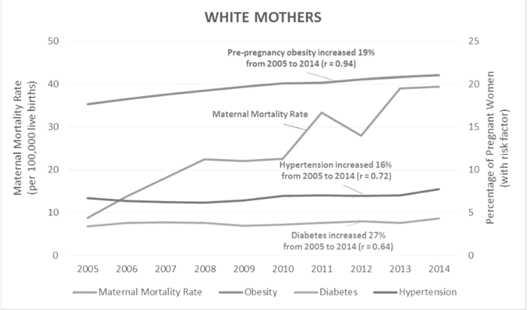

Slide 9
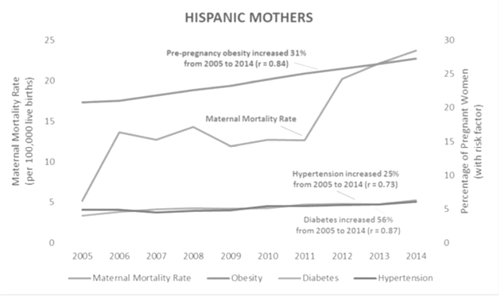
Prepared by: Office of Program Decision Support, Division for Family and Community Health Services, Texas Department of State Health Services, 08/24/2016. Data Sources: Death and Birth Files, Center for Health Statistics, Texas Department of State Health Services. MMR — computed within 42 days following the end of pregnancy, using ICD‐10 codes A34, O00‐095, O98‐O99. Pre‐pregnancy obesity; diabetes before and/or during pregnancy (including diabetes mellitus and gestational diabetes); and hypertension before and/or during pregnancy (including chronic hypertension, pre‐eclampsia, and eclampsia).

Slide 10
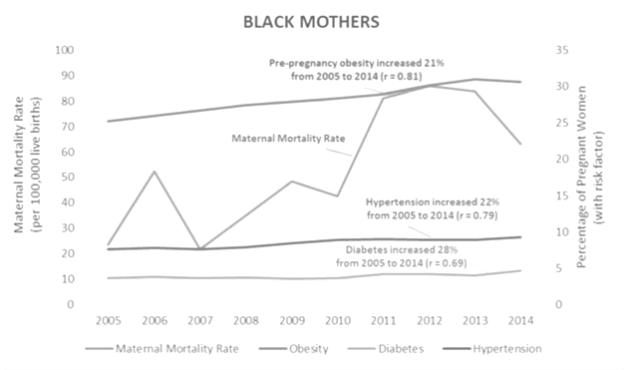
Prepared by: Office of Program Decision Support, Division for Family and Community Health Services, Texas Department of State Health Services, 08/24/2016. Data Sources: Death and Birth Files, Center for Health Statistics, Texas Department of State Health Services.
MMR — computed within 42 days following the end of pregnancy, using ICD‐10 codes A34, O00‐095, O98‐O99 (including chronic hypertension, pre‐eclampsia, and eclampsia)

Slide 11
Contributing Factors
Education
Access
Socioeconomic Status
Co-morbidities ( Hypertension, Diabetes, Obesity)
Middle Passage, 256 yrs Slavery= “Slave Health Deficit”
Bias
Stereotype
Institutional and Societal Racism
  “Cortisol Affect” = Living While Black

Slide 12

“It is not the ‘Jim Crow’ car proper that hurts our sensibilities, but the spirit that demanded its creation. It is not our color or what we ate today but the condition we arose from that keeps alive what is known as American prejudice.”
—The Freeman, 1891
“The past is of value only as it aids in understanding the present; and an understanding of the facts of the problem is the first step toward its solution.”
— Chicago Commission on Race Relations
“There is nothing more powerful than a people, than a nation, steeped in its history. And there are few things as noble as honoring our ancestors by remembering.”
— Lonnie Bunch, III, Curator Smithsonian
“If the problem of the 20th century was in WEB Dubois’ famous words ‘the problem of the color line,' then the problem of the 21st century is color blindness, the refusal to acknowledge the causes and consequences of enduring racial stratification.”
— Naomi Murakawa, Princeton

Slide 13
Black women are less likely to enter prenatal care in the first trimester
They are less likely to receive adequate care
Minority patients generally receive lower quality care even with equal access to care and insurance coverage
Alexander et. al. Racial differences in prenatal care use in the U.S.
IOM Unequal Treatment: Confronting Racial and Ethnic Disparities in Healthcare

Slide 14
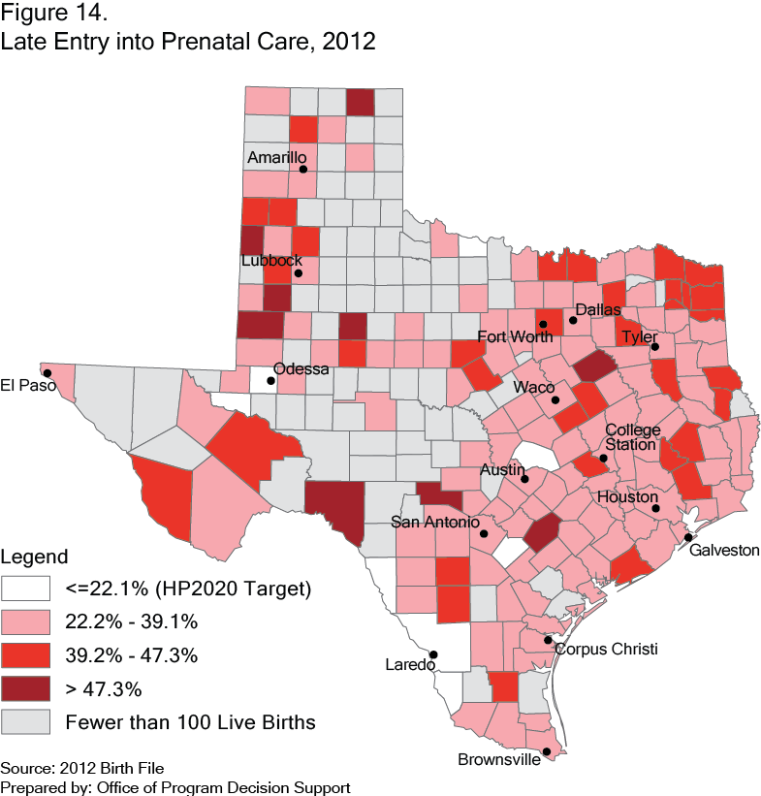
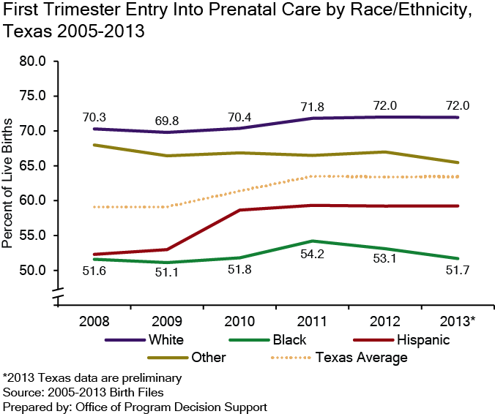
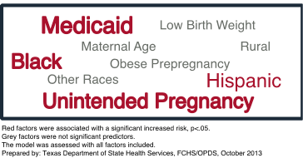
Maternal Care:
Prenatal Care
    Factors Associated with Late Prenatal Care:

Slide 15
Black - White Maternal Mortality disparity is the largest among all conventional perinatal health disparities
Black women consistently experience 4X greater risk of pregnancy related death than white women
This is independent of age, parity or education
Black women are more likely to die from complications of hemorrhage, hypertensive disorders and cardiomyopathy
National data set revealed Black women did not have statistically significant greater prevalence of pre-eclampsia, eclampsia, placental abruption or previa than white women but were 2-3X more likely to die from these conditions

Slide 16
Institutional Disparities
40 hospitals risk standardized severe morbidity rates
N = 353,773 deliveries 2011-2013
Severe morbidity 2.5% higher in Blacks than whites
Remained statistically significantly higher when controlled for patient characteristics and co-morbidities
65% of white mothers delivered at low-morbidity hospitals
23% of Black mothers delivered at low-morbidity hospitals
Study estimates that the difference in delivery location may contribute as much as 47% of the racial disparity in severe morbidity rates
Howell et al Site of delivery contribution to black-white severe morbidity disparity

Slide 17
Stereotypical Beliefs Lead to Bias
Black girls need less nurturing, less protection, less support, less comfort
Black girls are more independent
Black girls know more about adult topics and sex
Girl Interrupted, Georgetown Law Center on Poverty and Inequality

Slide 18
Implicit Bias
287 ER and IM residents, Atlanta and Boston
Does implicit racial bias impact recommendations regarding thrombolysis?
NO EXPLICIT BIAS REPORTED FOR WHITES VS BLACKS (measured by questionnaire)
Three implicit association tests
Implicit preference for white Americans and stereotypes of Black Americans
Green, Alexander, et al., Implicit Bias Among Physicians and Its Prediction of Thrombolysis Decisions for Black and White Patients, Journal of General Internal Medicine, Sept 2007

Slide 19
Impact
Fear
Lack of trust
Lower self esteem
Internalized racism

Slide 20
Persistent Inequity
15% of the population, US
30% of maternal deaths, US
4% of the physicians

Slide 21
Definitions
Cultural Knowledge- Familiarization with selected cultural characteristics, history, values belief systems and behaviors of members of another ethnic group (Adams, 1995)
Cultural Sensitivity- Awareness of existence of cultural differences and similarities without assigning values to differences ( National Maternal and Child Health Center on Cultural Competency, 1997)
Cultural Competence- Integration and transformation of knowledge about individuals and groups of people into specific standards, policies, practices and attitudes used in appropriate cultural settings to increase the quality of healthcare thereby producing better health outcomes ( Davis, 1997)

Slide 22


Maternal Mortality Rate,
California and United States; 1999-2010
Maternal Deaths per 100,000 Live Births
HP 2020 Objective – 11.4 Deaths per 100,000 Live Births
SOURCE: State of California, Department of Public Health, California Birth and Death Statistical Master Files, 1999-2010. Maternal mortality for California (deaths ≤ 42 days postpartum) was calculated using ICD-10 cause of death classification (codes A34, O00-O95,O98-O99) for 1999-2010. United States data and HP2020 Objective were calculated using the same methods. U.S. maternal mortality rates are published by the National Center for Health Statistics (NCHS) through 2007 only. Rates for 2008-2010 were calculated using NCHS Final Birth Data (denominator) and CDC Wonder Online Database for maternal deaths (numerator). Accessed at http://wonder.cdc.gov/ucd-icd10.html on Apr 17, 2013 8:00:39 PM. Produced by California Department of Public Health, Center for Family Health, Maternal, Child and Adolescent Health Division, April, 2013.
6
Notes:
TALKING POINTS: Updated 4.15.2013
California has now seen a decline in maternal mortality rates for three out of four years since 2006. The maternal mortality rate for 2010 is 9.2 deaths per 100,000 live births, similar to rates prior to 2003.
The maternal mortality rate for the U.S. was 16.8 in 2010.
Maternal mortality has similarly risen across the U.S. so that in 2010, the World Health Organization ranked the U.S. 50th among the cohort of 59 developed countries, (In 2007, the U.S. was ranked 41st, indicating a worsening status). WHO report.
The National Vital Statistics System (NVSS) will not report US maternal mortality rates until all states adopt approved data elements to capture maternal deaths on their death certificates. This is expected to occur in 2014.

Slide 23
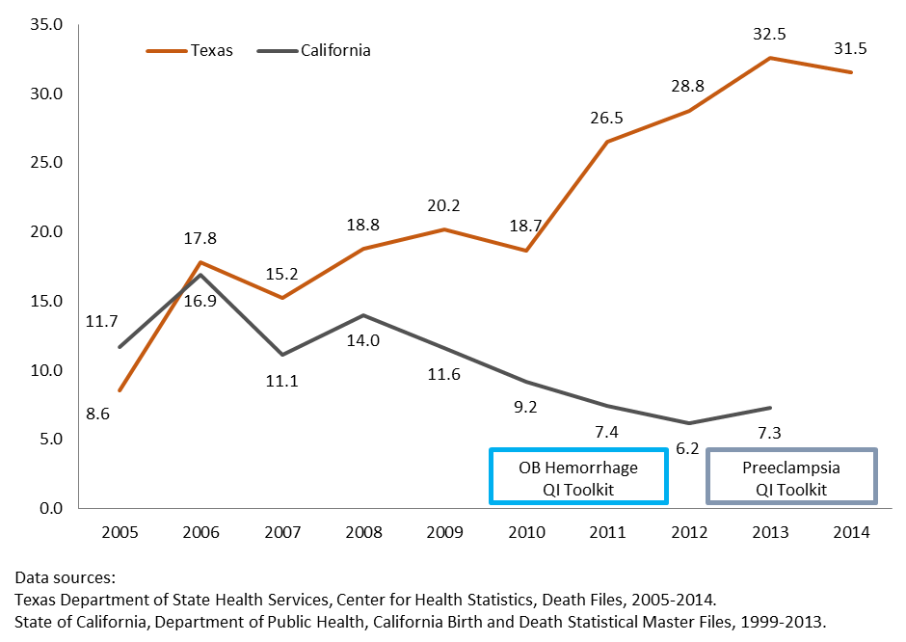
Texas Maternal Mortality
4
Notes:
SLIDE 5
Here now is the California maternal mortality rate using death certificate data and the same standard definition — death during pregnancy or within 42 days of end of the pregnancy.
Why is it so different?
There are many reasons, including the early recognition of the problem, thoughtful analysis, and sequential work to address the risks.
What this demonstrates is that significant improvement in maternal mortality can occur.

Slide 24
Maternal Mortality Rates by Race/Ethnicity, California Residents; 1999-2010
a
b
c
Maternal Deaths per 100,000 Live Births
a
b
b
c
c
a
SOURCE: State of California, Department of Public Health, California Birth and Death Statistical Master Files, 1999-2010. Maternal mortality rates for California (deaths ≤ 42 days postpartum) were calculated using the ICD-10 codes for 1999 to 2010. Produced by California Department of Public Health, Center for Family Health, Maternal, Child and Adolescent Health Division, December, 2012.
Notes:
TALKING POINTS, Updated 4.15.2013
The racial disparity in maternal mortality experienced by African-American women has increased and mostly widened over time, but we have begun to observe a reduction in maternal mortality rates among African-American women. In 2008-2010 mortality rates were 33.8 deaths per 100,00 live births. The disparity mortality ratio between Whites and Blacks also decreased to 3.2 in 2008-2010 (down from 3.8 in 2007-2009), suggesting that declines in maternal mortality were larger among African-American women.
In California, from 2008 to 2010, African-American women were roughly four times more likely to die from pregnancy-related causes with:
33.8 deaths per 100,000 live births, compared to
10.4 for Hispanic women,
10.7 for White women, and
9.6 for Asian women
This disparity in maternal deaths between African-American women and women of other racial/ethnic groups is the largest disparity among major public health mortality indicators.

Slide 25
Births & Maternal Deaths: 2005-2010 (CDC)
State | Births | Deaths | MMR
U.S. | 25,097,882 | 3759 | 15.0
California | 3,266,733 | 336 | 10.3
Texas | 2,386,792 | 405 | 17.0
New York | 1,492,774 | 305 | 20.4
Florida | 1,369,636 | 275 | 20.1
Illinois | 1,053,586 | 104 | 9.9
Pennsylvania | 884,214 | 130 | 14.7
Ohio | 882,650 | 157 | 17.8
Georgia | 863,897 | 168 | 19.4
North Carolina | 762,026 | 86 | 11.3
Michigan | 733,402 | 189 | 25.8
Louisiana | 383,234 | 42 | 11.0
Oklahoma | 323,454 | 97 | 30.0
Arkansas | 240,564 | 57 | 23.7

Slide 26
SOLUTIONS
Thorough review of maternal mortality and severe morbidity cases
Standardization of care through implementation of evidence based practices, e.g., AIM
Promote safe birth spacing via access to contraceptive methods
Increase first trimester entry into prenatal care presumptive eligibility; media campaigns on importance of early and consistent prenatal care
Use available geo mapping data on disparities to focus public health campaigns
Raise community awareness regarding the magnitude of as well as preventability of maternal mortality and severe morbidity, e.g., Honey Child Program
Support programs that emphasize primary care, disease prevention and the integration of reproductive and primary care, e.g., One Key Question
Increase access to high-quality healthcare to manage chronic illness during inter-conception periods of life
ADVOCATE FOR UNIVERSAL ACCESS TO CARE — HEALTHCARE SHOULD BE A RIGHT FOR ALL NOT A PRIVILEGE

Slide 27
Solutions - Individual
BLAMING THE VICTIM
DENYING IMPLICIT BIAS REGARDING GENDER, SOCIOECONOMIC STATUS AND RACE
STOP
LOOK
LISTEN
PATIENTS IN THE EYES
FOR OPPORTUNITIES TO EMPOWER
FOR EVIDENCE BASED BEST PRACTICES
WITHOUT JUDGEMENT
WITH EMPATHY

Slide 28


Slide 29
Acknowledgements
TMA President Dr. Carlos Cardenas
TMA Staff Helen Kent Davis, Margaret Mendez, Sam Cooper, Karen Batory and their teams
DSHS: Dr. Manda Hall, Dr. Karen Ruggiero, Sonia Baeva, Julie Stagg and their teams
Maternal Mortality and Morbidity Task Force – Dr. Lisa Hollier
Texas Collaborative for Healthy Mothers And Babies – Drs. George Saade And Michael Speer
March Of Dimes Honey Child Program – Dr. Charleta Guillory
THANK YOU

