Slide 1
Overview of Maternal Health Issues
John Hellerstedt, M.D.
Commissioner, Texas Department of State Health Services
Lisa Hollier, M.D., M.P.H.
Chair, Maternal Mortality & Morbidity Task Force
Texas Medical Association • Maternal Health Congress • March 24, 2018

Slide 2
Objectives
Statewide Data Trends
Challenges and barriers related to maternal mortality and morbidity
Population health disparities in maternal health
Public Health Initiatives
3. Evidence-based quality initiatives for improving maternal health
4. State agency resources for accessing care
5. Client service programs for substance use

Slide 3
Let us have a moment of silence for the families in Texas forever impacted by the loss of a mother

Slide 4
Statewide Data Trends

Slide 5
Confirmed Maternal Deaths by Timing and Cause of Death, 2012-2015
Cause of Death | While Pregnant | 0-7 Days Post-partum | 8-42 Days Post-partum | 43-60 Days Post-partum | 61+ Days Post- partum |  | Total
Amniotic Embolism | 1 | 9 | 0 | 0 | 0 |  | 10
Cardiac Event | 2 | 12 | 9 | 5 | 27 |  | 55
Cerebrovascular Event | 0 | 8 | 9 | 1 | 9 |  | 27
Drug Overdose | 0 | 3 | 7 | 5 | 49 |  | 64
Hemorrhage | 3 | 12 | 2 | 0 | 3 |  | 20
Homicide | 2 | 1 | 5 | 2 | 32 |  | 42
Hypertension/Eclampsia | 0 | 7 | 4 | 0 | 7 |  | 18
Infection/Sepsis | 1 | 3 | 14 | 3 | 11 |  | 32
Pulmonary Embolism | 2 | 3 | 4 | 2 | 2 |  | 13
Substance Use Sequelae (e.g., liver cirrhosis) | 0 | 0 | 2 | 0 | 3 |  | 5
Suicide | 0 | 1 | 2 | 2 | 28 |  | 33
Other | 5 | 5 | 6 | 3 | 44 |  | 63
Total | 16 | 64 | 64 | 23 |  | 215 | 382

Slide 6
Role of Opioid Overdoses in Maternal Deaths, 2012-2015
Drug overdose leading cause of maternal death,
mostly occurring after 60 days postpartum
Combination of drugs involved in 77%
Opioids detected in 58%
Demographic groups at higher risk:
White women
Ages 40+
Medicaid at delivery (low socioeconomic status)
Urban counties
Region 2/3 (includes Dallas-Fort Worth) and
Region 1 (Panhandle)

Slide 7
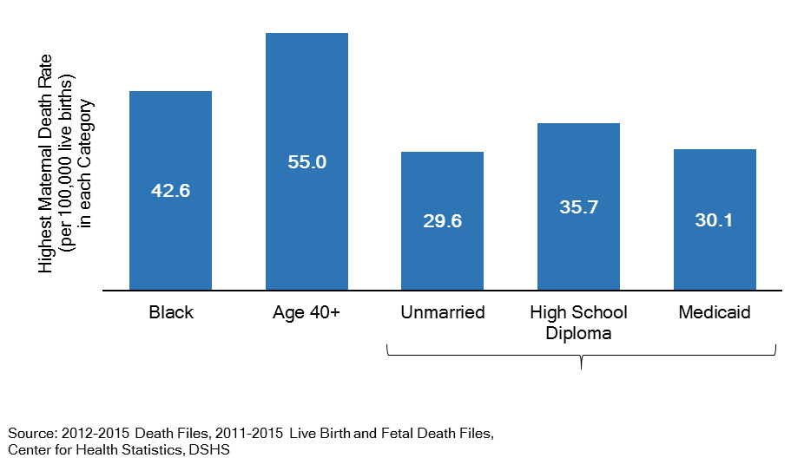
Demographic Risk Factors for Maternal Death, 2012-2015
Low Socioeconomic Status

Slide 8
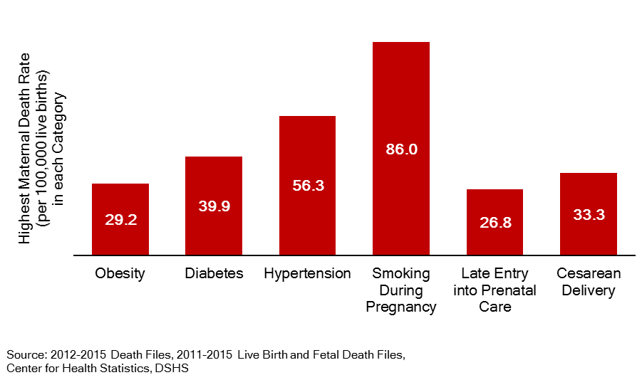
Health Risk Factors for Maternal Death, 2012-2015

Slide 9
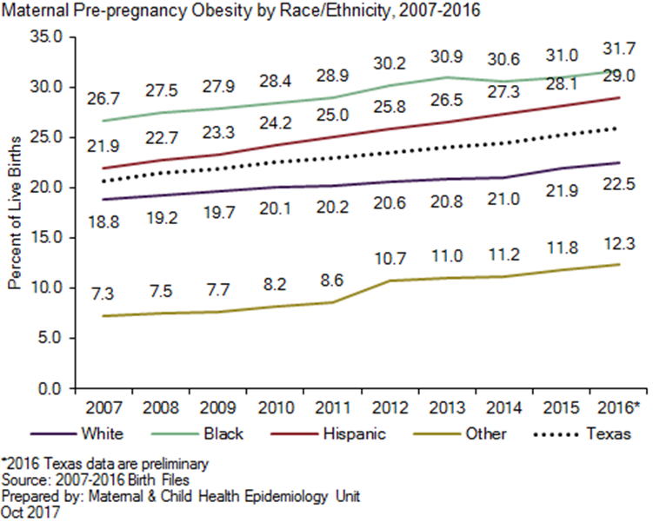
Pre-pregnancy Obesity by Race/Ethnicity, 2007-2016

Slide 10
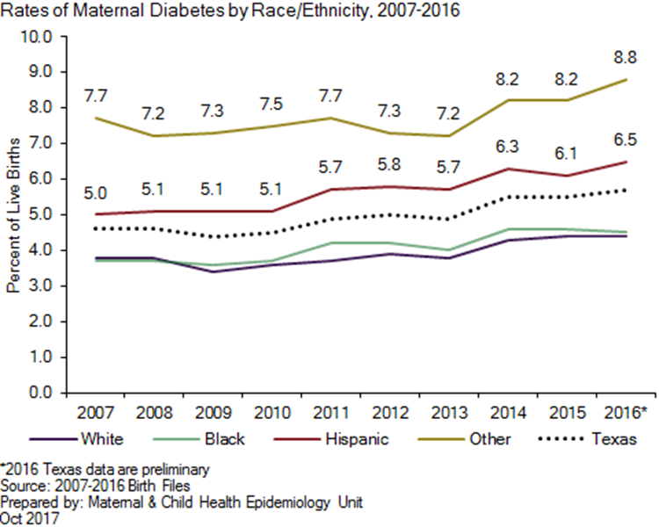
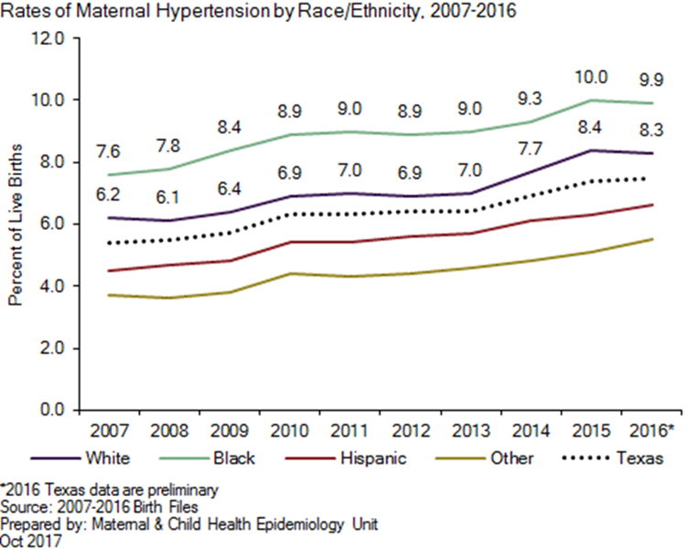
Maternal Diabetes and Hypertension by Race/Ethnicity, 2007-2016
MATERNAL DIABETES
MATERNAL HYPERTENSION

Slide 11
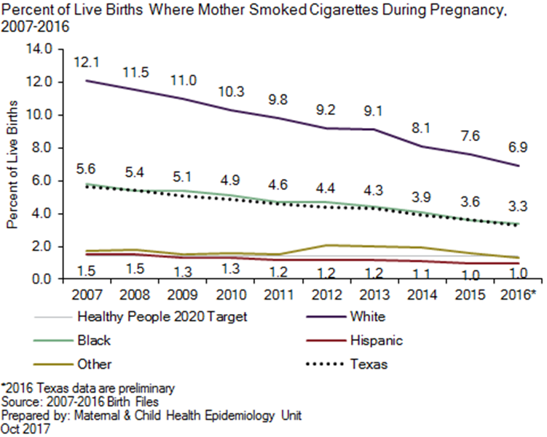
Smoking during Pregnancy by Race/Ethnicity, 2007-2016

Slide 12
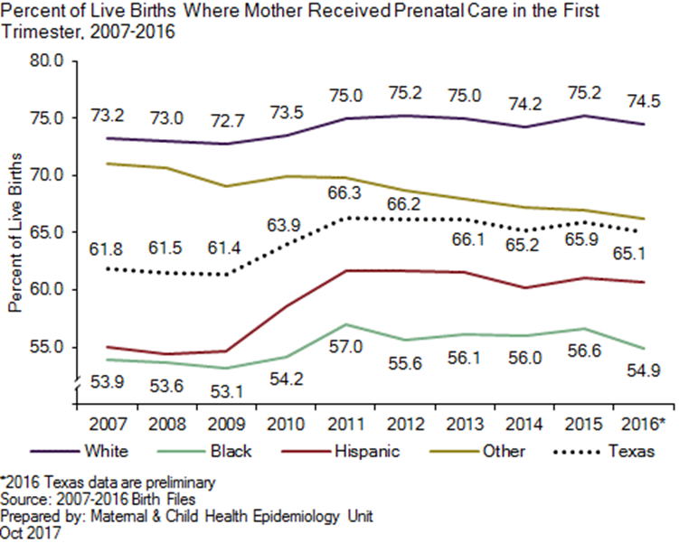
Timely Prenatal Care by Race/Ethnicity, 2007-2016
However, among those not receiving care in first trimester, 51.5% still reported receiving prenatal care as early as they wanted
(Texas Pregnancy Risk Assessment Monitoring System, 2015)

Slide 13
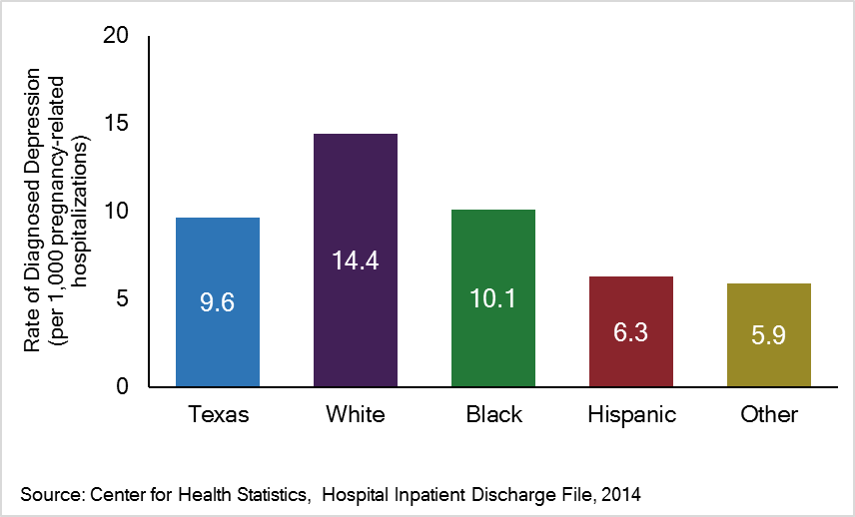
Depression during Pregnancy-related Hospitalization by Race/Ethnicity, 2014

Slide 14
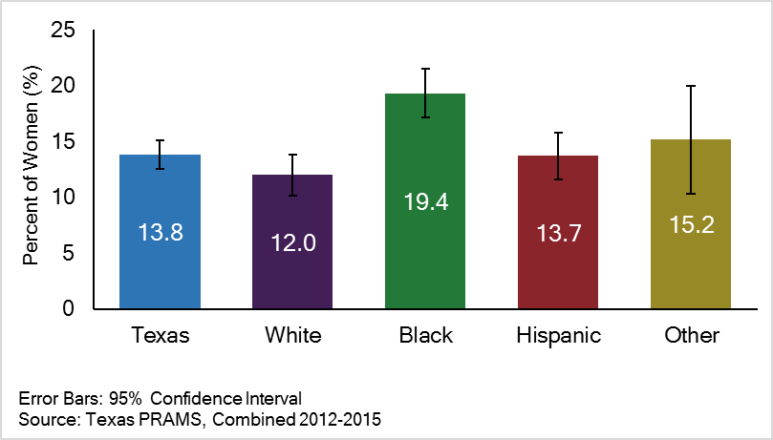
Percent of Postpartum Depression Reported by Recent Texas Mothers by Race/Ethnicity, 2012-2015

Slide 15
Severe Maternal Morbidity
Unexpected outcomes of labor and delivery resulting in significant short- or long-term consequences to a woman’s health
Identified using specific ICD codes for delivery hospitalizations
Examples include:
Hemorrhage
Eclampsia
Emergency hysterectomy
Thrombotic embolism

Slide 16
Severe Maternal Morbidity, Overall and Top Causes, 2014

Slide 17
Obstetric Hemorrhage Rates by Race/Ethnicity, 2005-2014

Slide 18
Obstetric Hemorrhage Rates by County of Residence, 2010-2014

Slide 19
Percent of Hospitalizations due to Obstetric Hypertension by Race/Ethnicity, 2005-2014

Slide 20
Percent of Hospitalizations due to Obstetric Hypertension by County of Residence, 2010-2014

Slide 21
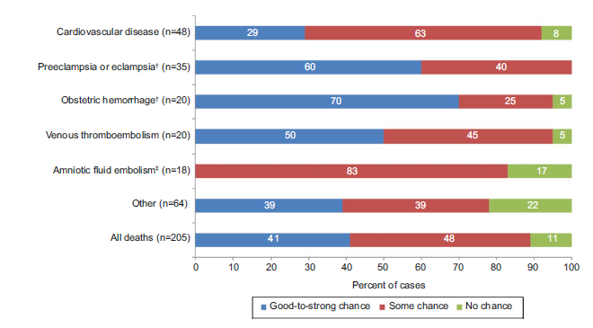
Maternal Mortality and Morbidity are Preventable
From: Main et al. Obstet Gynecol 2015;125(4):938-947

Slide 22
AIM Maternal Safety Bundles
Instructions, checklists, and supplies for health care staff to effectively prepare, identify, and prevent severe maternal morbidity due to specific causes
Evidence-based best practices for maternity care endorsed by many national organizations, including ACOG

Slide 23
Severe Morbidity Reduction - Hemorrhage
Hospitals that implemented hemorrhage safety bundle had 11.7% decrease in severe maternal morbidity among all obstetric patients (compared to baseline)
Main et al. Am J Obstet Gynecol 2017;216(3):298.e1-298.e11.

Slide 24
Severe Morbidity Reduction
The four initial AIM states submitted baseline data for three years prior to joining the initiative
Each state’s baseline data indicated a severe maternal morbidity rate between 1.9% to 2.1%
Data from AIM participating hospitals in those same states for the second to fourth quarter of 2016 (collectively representing 266,717 births) showed a reduction in the severe maternal morbidity rate to 1.5% to 1.9% — an overall 20% decrease
ACOG Press Release, January 2018

Slide 25
Public Health Initiatives

Slide 26
Increase Death Certificate Accuracy
To more efficiently identify maternal deaths from pregnancy status and cause of death as intended, consistent with Rider 36 (85th Texas Legislature)
Action plan calls for:
Focused outreach
Best-practice guidelines
(Senate Bill 1599, 85th Texas Legislature)
Training and education
Texas Electronic Vital Events Registrar (TxEVER)

Slide 27
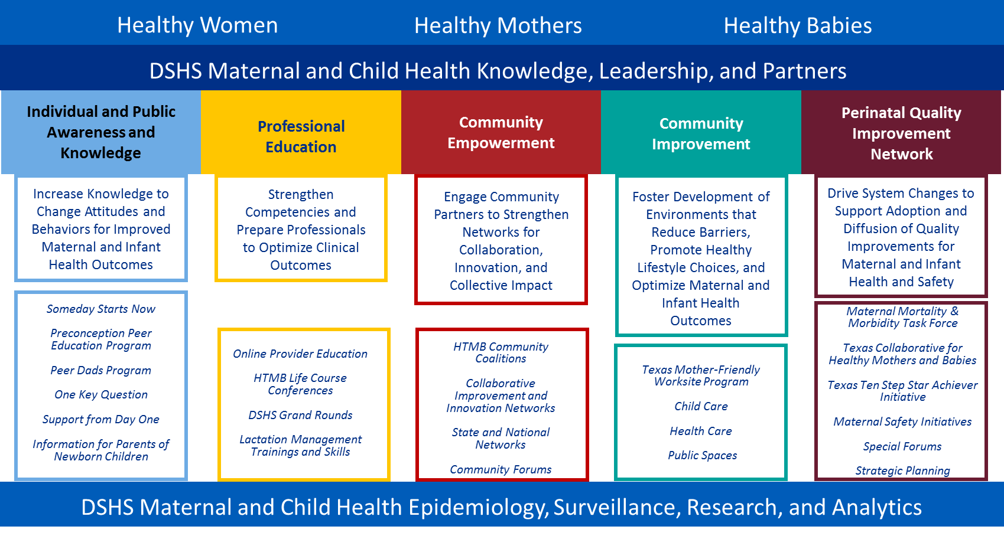
Healthy Texas Mothers and Babies
Individual and Public Awareness and Knowledge
Perinatal Quality
Improvement
Network

Slide 28
Individual and Public Awareness and Knowledge
To emphasize importance of:
Healthy living
Timely prenatal care
Role of health disparities
Chronic disease risk factors
Key initiatives:
Someday Starts Now
Preconception Peer Education
One Key Question

Slide 29
Perinatal Quality Improvement Network
To drive adoption and diffusion of quality improvements for maternal and infant health and safety
Key initiatives:
Risk appropriate maternal care
AIM maternal safety bundles

Slide 30
Risk Appropriate Care
Risk Appropriate Maternal Care
To ensure pregnant women at high risk receive care in facilities prepared to provide required level of specialized care
DSHS is responsible for establishing rules for maternal level of care designation
DSHS will also be calculating maternal health outcome measures for ongoing monitoring and re-designation

Slide 31
House Bill 15 83rd Legislature, Regular Session
Sec. 241.183. LEVEL OF CARE DESIGNATION RULES.
(a) The executive commissioner, in consultation with the department, shall adopt rules:
(1) establishing the levels of care for neonatal and maternal care to be assigned to
hospitals;
(2) prescribing criteria for designating levels of neonatal and maternal care, respectively,
including specifying the minimum requirements to qualify for each level designation;

Slide 32
Implement AIM Maternal Safety Bundles
TexasAIM Maternal Safety Bundles
To reduce severe maternal morbidity using evidence-based systems to enhance maternal care
Implementing AIM bundles for:
Obstetric hemorrhage
Severe hypertension in pregnancy
Obstetric care for women with opioid use disorder
Next steps:
Enrolling hospitals on a voluntary basis
DSHS AIM information webinar (March 28th)
Maternal Safety Needs Assessment Survey
For more information, email TexasAIM@dshs.texas.gov or visit www.dshs.texas.gov/mch/TexasAIM.aspx

Slide 33
Senate Bill 17 85th Legislature, 1st Special Session
Sec. 34.0156. MATERNAL HEALTH AND SAFETY INITIATIVE.
(a) Using existing resources, the department, in collaboration with the task force, shall promote and facilitate the use among health care providers in this state of maternal health and safety informational materials, including tools and procedures related to best practices in maternal health and safety.

Slide 34
Inter-Agency Policy Workgroup
To ensure coordinated policy for maternal health issues, including prenatal and postpartum care for chronic disease and behavioral health
HHSC client programs:
Women’s Health Services
Behavioral Health Services
Medicaid Services

Slide 35
Thank you

