Slide 1
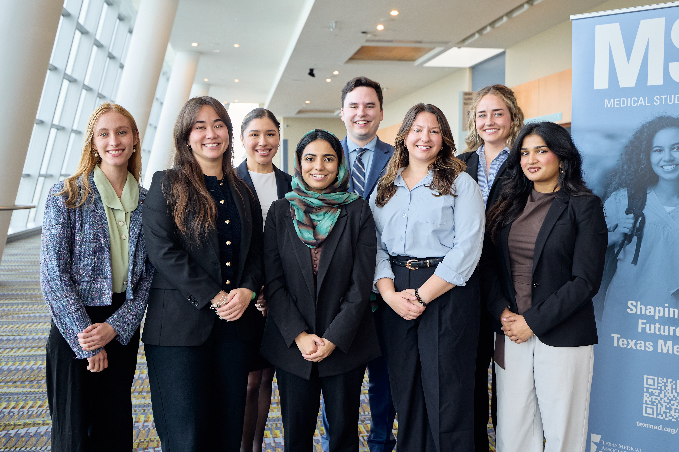

Texas Medical Association
Medical Student Membership
Notes:
Hello, my name is _Name_________ and as the current _Title________ of the TMA Medical Student Section it’s my pleasure to congratulate you for being accepted into medical school. We are so glad to have you in Texas!
I also want to welcome you to membership in the Texas Medical Association and your county medical society, where student membership is completely FREE! Simply activate your account on the TMA Website.

Slide 2
So, Who Is TMA?
Nation’s largest state medical Association
60,000+ physician and medical student members
110 component medical societies
Representing all medical specialties and practice settings
Proven legislative regulatory, and legal advocacy successes
Notes:
The Texas Medical Association is your professional organization. But we are also much more than that, we are the largest state medical association in the country representing more than 60,000 physicians, resident/fellow and medical students in all specialties. And we are best known for our legislative, regulatory and legal advocacy successes.
Additionally, the amount of benefits and services provided through your membership is vast. Over the next few minutes, I will provide a brief overview of the opportunities provided with your membership.

Slide 3

TMA Medical Student Section
As a section member,
you can:
Provide TMA with the student perspective.
Meet medical students from across the state.
Elect local, state and national officers.
Craft policies and resolutions to shape the future of medicine.
Adress issues unique to students.
Notes:
The TMA Medical Student Section, or MSS, is an interest group within TMA that was established to address issues and provide services specific to student needs. You automatically become a member of the Medical Student Section with membership in TMA. The section typically meets three times annually in conjunction with TMA conferences to conduct business, hear from speakers, and find time to have some fun.

Slide 4
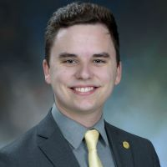

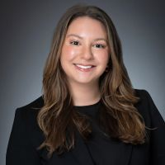

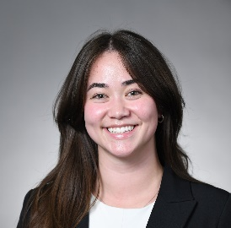
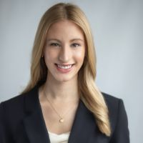

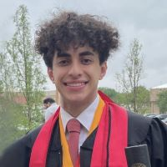
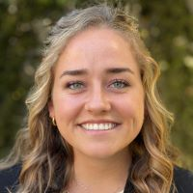
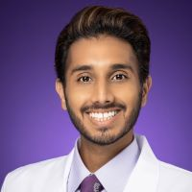
2026-27 TMA MSS Executive Council
Chair Grayson Jackson MS, PhD, UTMB | Vice Chair Yushra Rashid MS4, Texas A&M | Reporter Avery Arsenault OMS2, TCOM | TMA Delegate Co-chair Niza Garcia MS3, Paul L Foster
TMA Delegate Co-chair Victoria Teoh MS3, UTMB | AMA Delegate Co-chair Camille Bourgeois MS3, McGovern | AMA Delegate Co-chair Samyuktha Senthil Kumar MS2, McGovern | Alt Del, TX Delegation to the AMA Andrew Ibrahim MS4, Texas Tech
TMA MSS Staff Karen Kollar Karen.Kollar@texmed.org Laura Lang Laura.Lang@texmed.org | TMA BOT Student Member Natalie Barnett MS4, TCU | Immediate Past Chair Parminder Deo MS4, TCU | Texas Medical Association 401 W 15th Street (512) 370-1300 (800) 880-1300 www.texmed.org
Notes:
The section’s executive council is a group of leaders who direct activities on the state level.
This group consists of students who go to medical schools across TX: from UTMB, TCOM, TX Tech, Paul L Foster, A&M and McGovern.
Elections for this group happen during their business meeting at TMA’s annual conference.
TexMed.org/mss will be your most valuable resource for section opportunities and deadlines.

Slide 5
Top Reasons to Belong to TMA
(according to past member surveys)
1. Advocacy
2. Benefits and Services
3. News and Information
4. Insurance
Notes:
TMA members surveyed have continuously listed these as the top four reasons to belong to TMA. I’ll briefly cover each of these items, how they are beneficial to you and how you can tap into them, in the following slides.

Slide 6
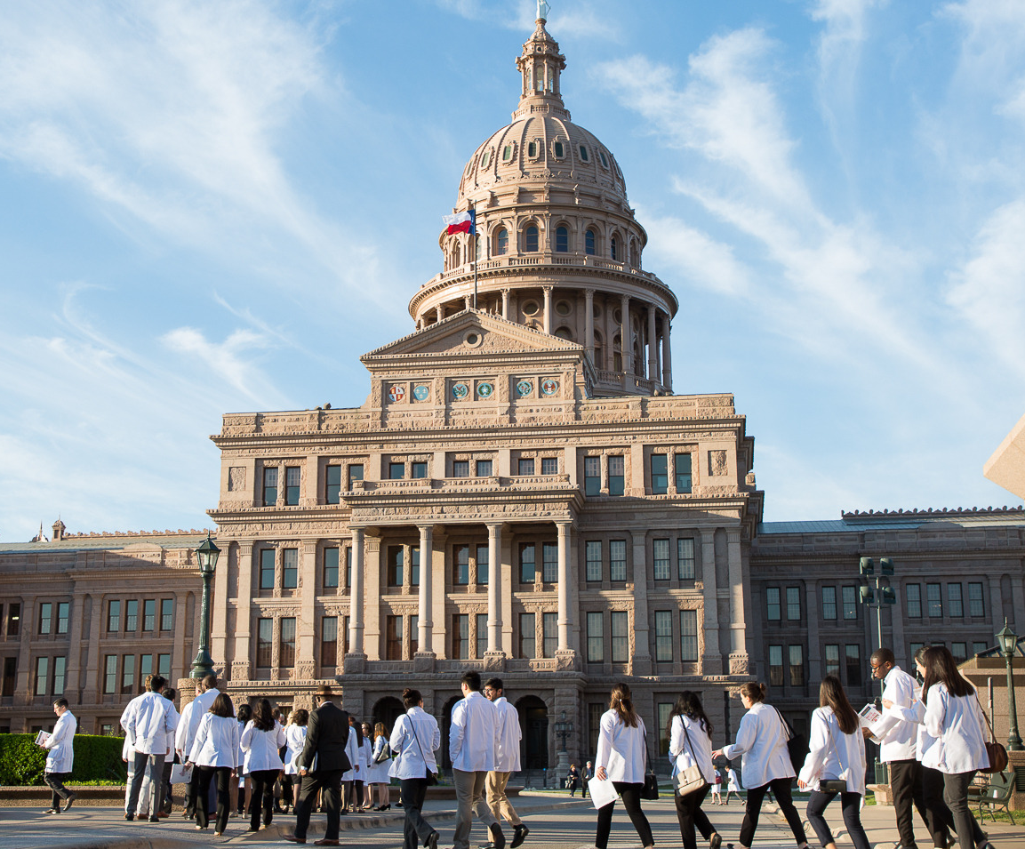
Advocacy
What we do together, no one physician can do alone
TMA advocates for Texas medicine on key issues:
Enhancing health care access,
Safeguarding medical liability protections,
Increasing GME budgets,
Improving women’s health care,
Adress issues unique to students, and
Curbing prior authorization requirements, and more.
texmed.org/Advocacy
Notes:
TMA is best known for its’ legislative, regulatory, and legal advocacy efforts. But without the grassroot support of physicians and students, their success would not be possible.
The Texas legislature meets every other, odd-numbered, year for 140 days. On the first Tuesday of every month during the session, physician members arrive en masse to lobby on behalf of issues important to medicine and the patients we serve. It is because of these grassroots efforts from members that TMA’s advocacy efforts have been strong.
- 2027 is a legislative year. Be on the lookout for opportunities to lobby your legislators at the capitol in April when students and residents are invited for a special First Tuesdays designated to students and residents.

Slide 7
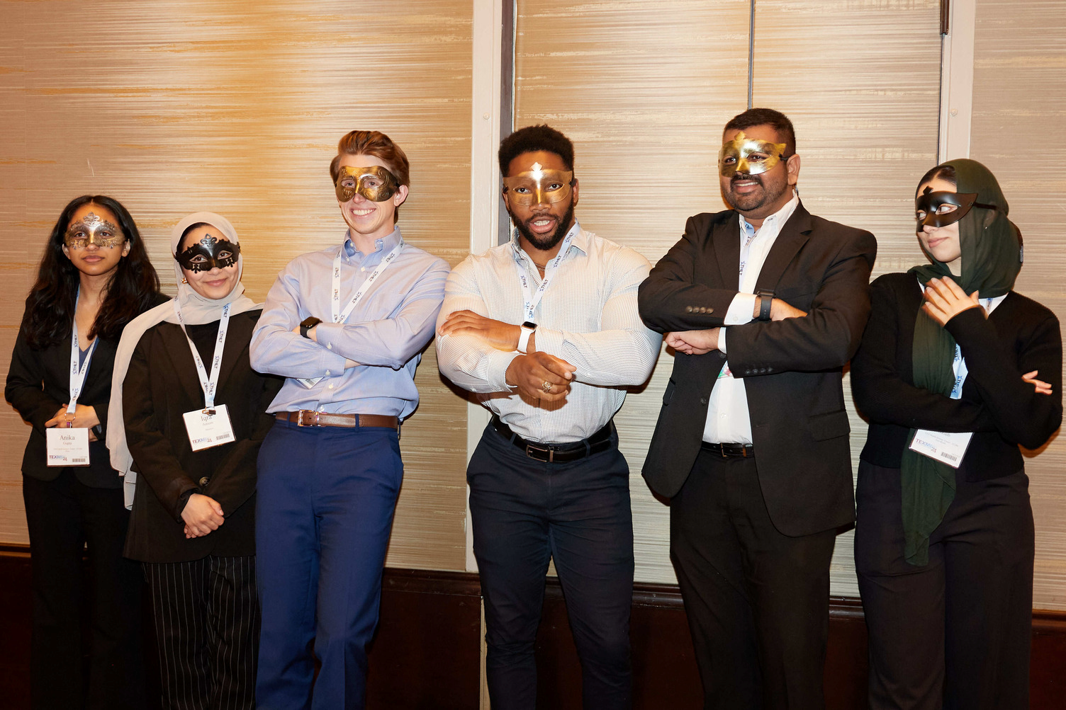
Networking
Meet students and physicians from across the state
Opportunities include:
Advocacy events,
Local chapter and county medical society (CMS) meetings,
State (TMA) conferences, and
National (AMA) conferences.
texmed.org/Events
Notes:
Via your involvement with TMA there are many opportunities to connect with peers locally or at state and national conferences. The section meets in conjunction with TMA conferences. And in Texas, there is no better way to be introduced to physician leaders, possible mentors, or future employers.

Slide 8
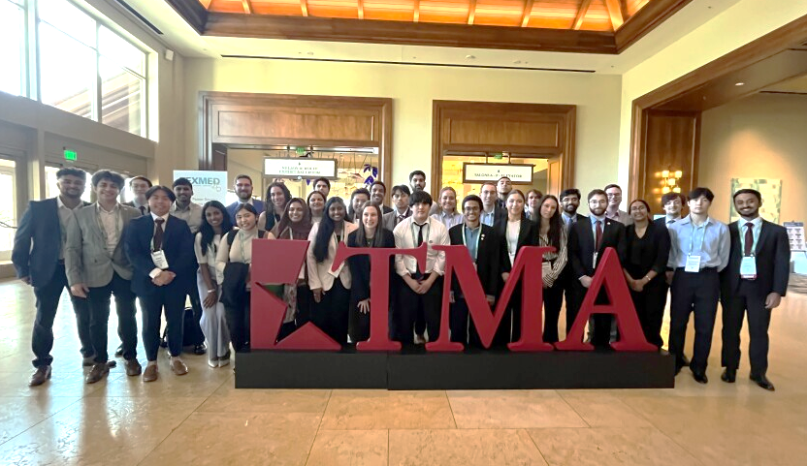
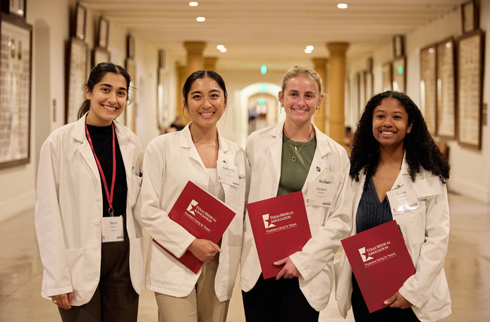
Leadership
Help shape the trajectory of
Texas medicine
Opportunities include:
State
Local Chapter Leadership Positions
TMA Board, Council, and Committee
TMA MSS Executive Council
TMA Delegates and Alternate Delegates
National
AMA MSS Delegates
AMA Region Leadership Positions
AMA Sectional Delegates
texmed.org/Students
Notes:
You will find various opportunities to build your CV, improve your skill set, and take on leadership roles. There are seats on every TMA Board, Council and Committee specifically for students (surely there is something of interest to you). Additionally, the section is led by an executive council made up of students elected by their peers. There are also opportunities to represent the section as a voting member within the association’s House of Delegates to help craft policies and resolutions to shape the future of medicine.

Slide 9

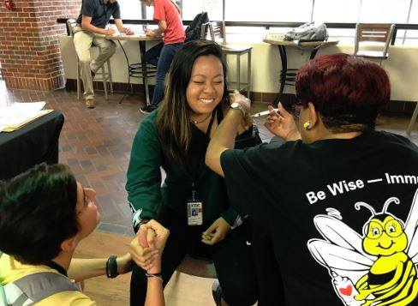

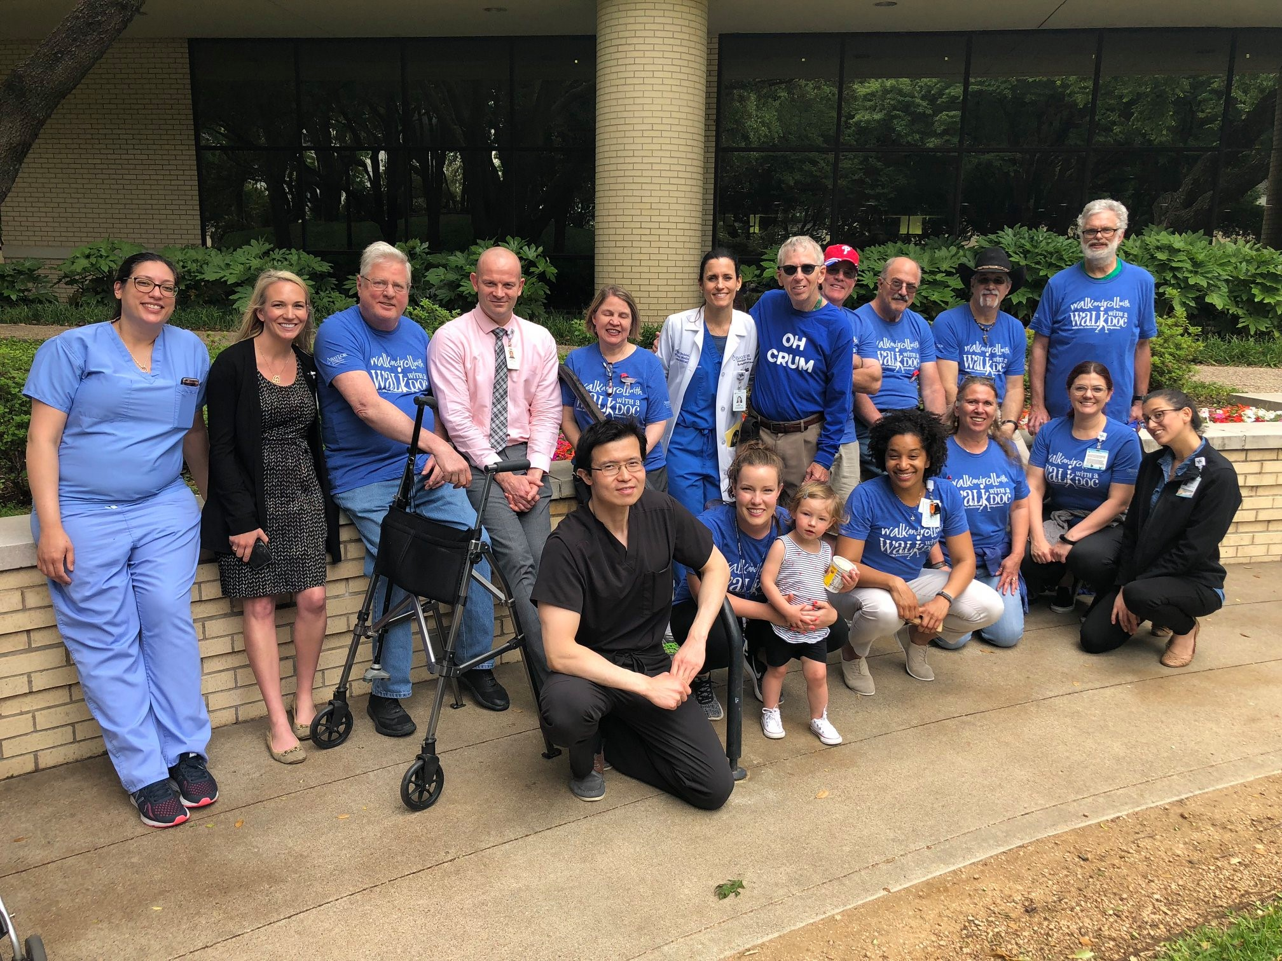
Public Health & Outreach
Host or lead an event in your community
Established programs include:
  Hard Hats for Little Heads,
  Walk With a Doc,
  Vaccines Defend What Matters,
  Texas Bookshare, and
  TMA Foundation and Alliance
  initiatives
texmed.org/CommunityOutreach
Notes:
TMA knows it’s important for you to give back and improve the health of your community. There are several turn-key opportunities to allow you to do so including:
Hard Hats for Little Heads, a bicycle helmet safety program for kids.
Walk With a Doc, a national program to encourage healthy physical activity through physician-led walks.
Vaccines Defend What Matters (formerly Be Wise – Immunize) is TMA’s integrated, multimedia public health education and advocacy effort to overcome vaccine hesitancy and increase vaccination rates in Texas.
Be sure to reach out to the TMA Foundation to learn more about all of the grants they have available to host one of these programs.

Slide 10
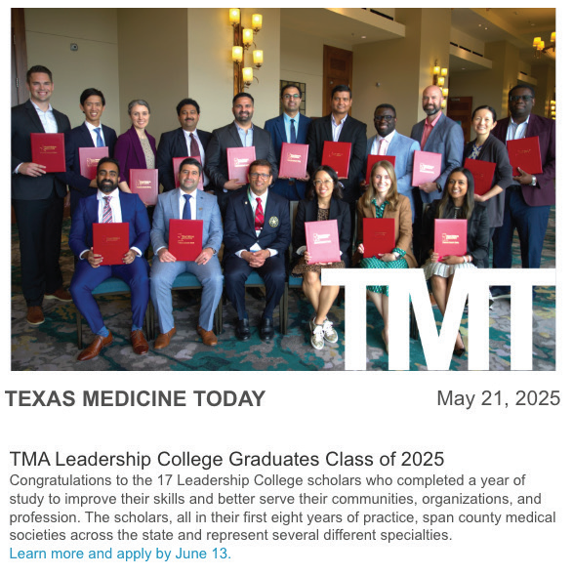


News & Information
Keep abreast of the latest news and regulatory developments
Receive essential news including:
  Texas Medicine
  TMA’s bi-monthly magazine
  texmed.org/TexasMedicine
  Texas Medicine Today
  Daily e-newsletter
  texmed.org/TexasMedicineToday
  Podcasts
  Health Beat
  texmed.org/HealthBeatPodcast
  Let Doctors be Doctors
  texmed.org/LetDoctorsBeDoctors
texmed.org/TMAPublications
Notes:
Be sure to login to your online member portal and update your personal information (including mailing address) to ensure you are receiving Texas medical news and information via Texas Medicine magazine. You can also customize your interests to tailor the latest news you receive in Texas Medicine Today, TMA’s daily e-newsletter.

Slide 11

Sounds Great! How Much?
Complete your application today!
FREE STUDENT
MEMBERSHIP
Student dues are FREE to join both the Texas Medical Association and your county Medical Society.
texmed.org/Join
Notes:
As a reminder... dues to join TMA and your local county medical society are completely FREE and will take you through the remainder of your medical school training! But your membership will mean so much to our profession, to you, and to the patients we serve. Be sure to join today!
And don’t forget to join AMA. If you join for 4 years at $68 you will receive a premium gift of your choice, along with so many other great benefits and services.

Slide 12



Stay Connected!
Section Information:
MSSInfo@texmed.org
texmed.org/students
TMA Knowledge Center:
(800) 880-7955
knowledge@texmed.org
texmed.org/information
TMA Social:
facebook.com/Texmed
@texmed
@weareTMA
Notes:
So, I invite you to join by visiting texmed.org/join today! Once you’ve joined be on the lookout for an email from TMA with links to help you navigate the benefits and services we have talked about today. In the meantime, if you have questions or need help, don’t hesitate to reach out! ….MSSInfo@texmed.org
Welcome to Texas and to Texas medicine!!!

