Slide 1
City of Laredo Health Department
Serving all of Webb County
2600 Cedar Avenue
Laredo, Texas 78040
Phone: (956) 795-4900 Fax: (956) 726-2632
Hector F. Gonzalez, M.D., M.P.H., Health Director

Slide 2
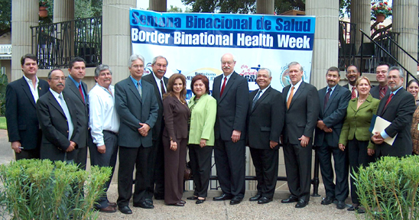

Los Dos Laredos Bi-National Council
Since September 1998
Meets monthly alternating between Laredo, Texas and Nuevo Laredo, Tamaulipas.

Slide 3
Los Dos Laredos Bi-National Council
Meet every to address diverse and challenging issues that impact the region of Los Dos Laredos and Nuevo Leon.
Issues are prioritized to address public health and health care issues.
Six permanent sub committees
  HIV/STD, Epidemiology, Obesity, Environmental Health, Tuberculosis Control, Cancer Detection and Prevention

Slide 4
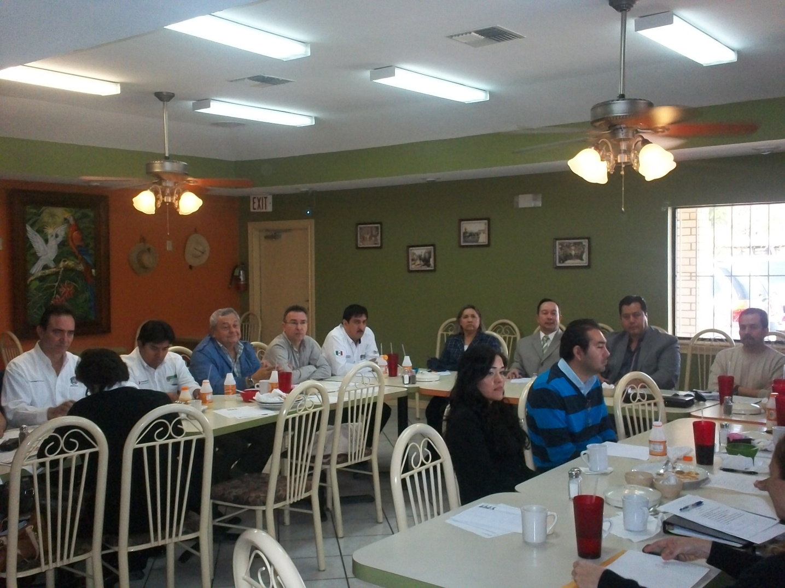
Cooperation, Collaboration Coordination and Communication

Slide 5
Cooperation, Collaboration Coordination and Communication
Tuberculosis - surveillance, early detection, testing, treatment and prevention, joint workshops
Epidemiology -share morbidity and mortality information to detect trends and rapid response.
Environmental Health – for food and waterborne disease prevention, all hazards prevention, zoonosis prevention and vector borne disease prevention
Obesity Prevention – joint efforts in schools and community at large
HIV/STD – prevention and detection
Cancer – early detection and prevention
Maternal and Child Health – early access to care, family planning, women's health, well child dental care
Immunizations – information sharing, vaccine preventable disease prevention, training workshops

Slide 6
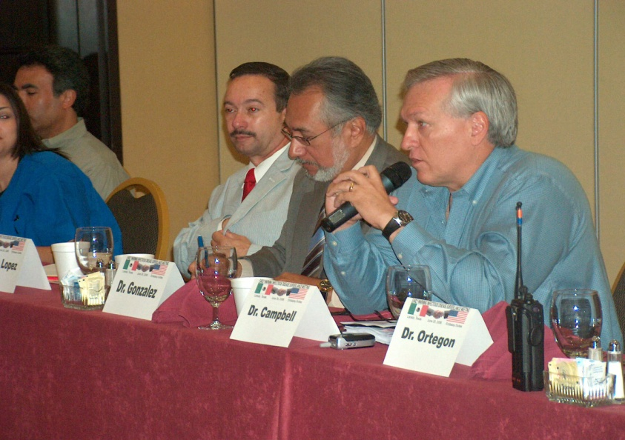
Previous Topics
HIV Bi-National Coalition – “Binomio HIV-TB”
Nutrition, Obesity, Diabetes Prevention
Tuberculosis, “the challenges”
EWIDS-”Information Exchange” “SNS POD Drive Thru”
BIDS-Erlichiosis, St. Louis Encephalitis
Environmental Health- Border 2012, CARE Grant
Ventanillas de Salud- Mexican Institute
Operation Lone Star- Zapata, Jim Hogg, Webb, 4,000
Shigellosis
H1N1
Carrizo Cane Herbicide Application
Bi-national Border Health Week
Public Health Week
World Aids Day
Ventanillas De Salud

Slide 7
Members
City of Laredo Health Department
Secretaria De Salud Jurisdicción #5
Department of State Health Services-Office of Border Health
Secretaria De Salud Estado de Tamaulipas
University of Texas Health Science Center-San Antonio, Laredo Campus
Texas A&M International School of Nursing
Universidad Autonoma de Tamaulipas Escuela de Enfermeria
Laredo and United Independent School Districts
United States-Mexico Border Health Commission Outreach Office from both the US and Mexico Sectors
Texas Commission on Environmental Quality,
Internal Boundaries Water Commission
Ecologia
Health and Human Services Commission
Instituto del Seguro Social, ISSTE
AHEC

Slide 8
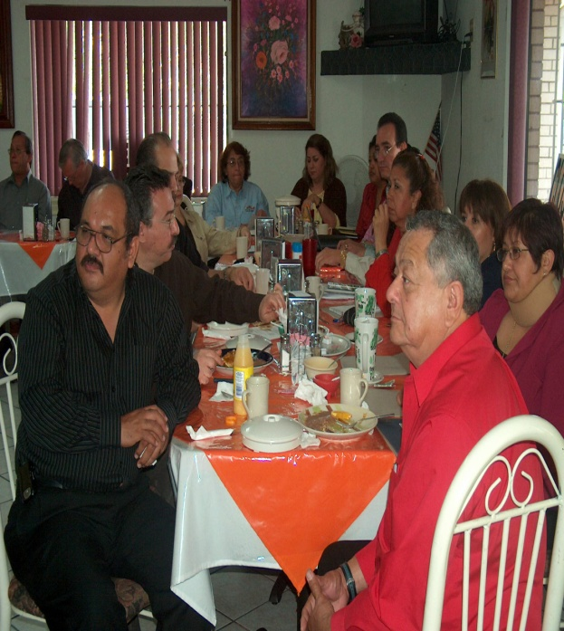
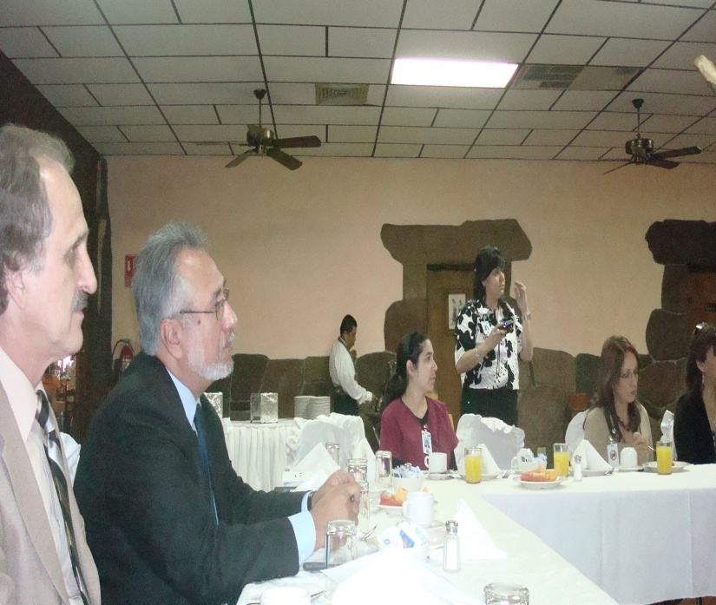
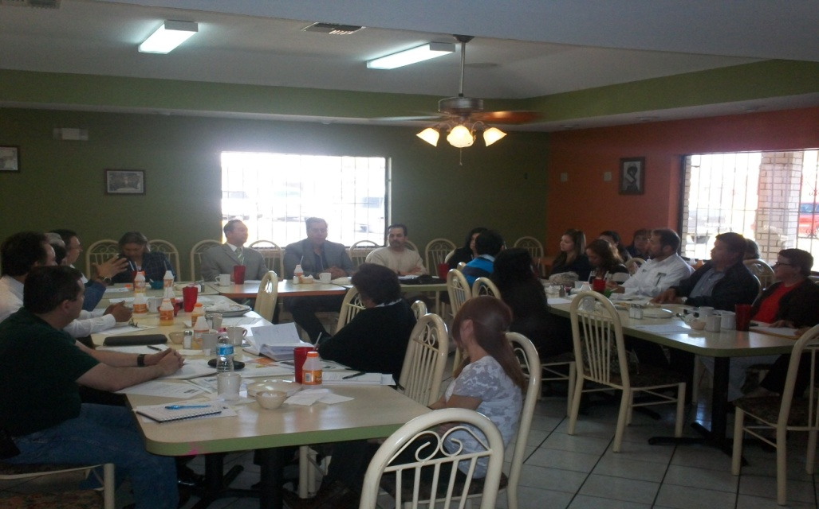
Bi-National Meetings

Slide 9
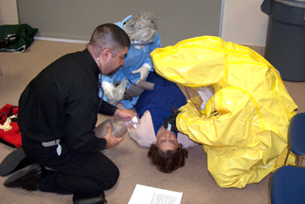
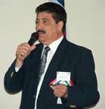
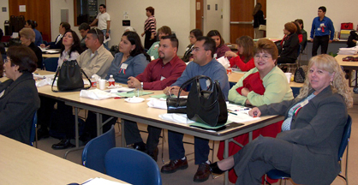
TB Bi-National Conference

Slide 10
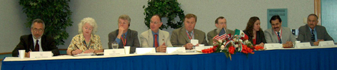
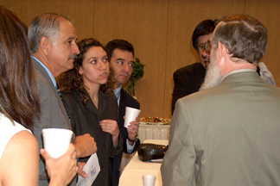
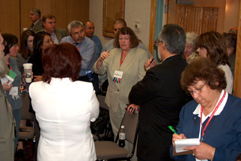
Public Health
Preparedness and Response

Slide 11
Strategy & Action
Develop Health Promotion Campaigns to increase physical activity, fruits and vegetables, reduce consumption of sugar sweeten beverages, reduce intake of dietary fat and promote portion control.
Increase percentage of children and youth making healthier choices and participating in physical activities.

Slide 12
Border Bi-National Health Week
Highlight On-going Border Health Activities
Bi-National Obesity, Education, and Diabetes Screening
Forum: Progress Report on Obesity Control in the Schools
Additional Activities: Flu Vaccines & HIV Screening

Slide 13
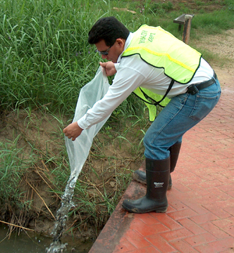
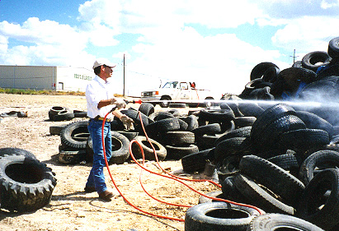
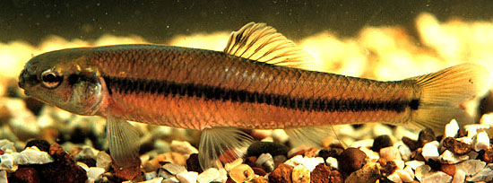
Vector Control
The City of Laredo Environmental Health Division regularly sprays and drops larvacide, especially during peak seasons.
The deposit of minnows in bodies of water helps eliminate larvae and thus controls the proliferation of mosquitoes.

Slide 14
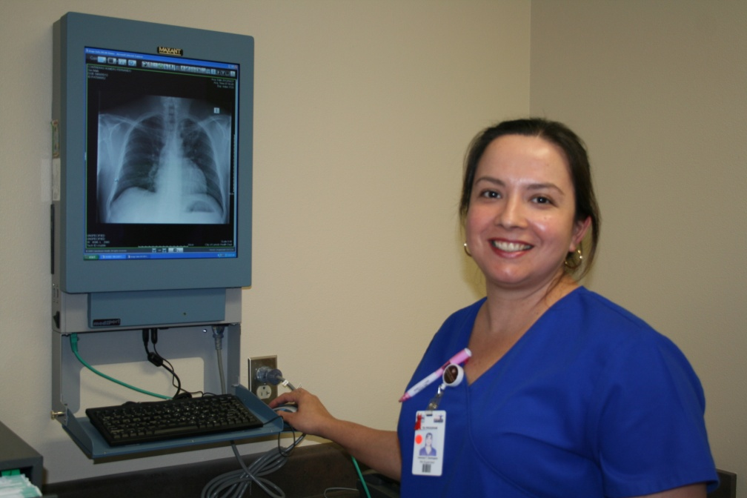
Tuberculosis Elimination Program
Epidemiology
Detection
Treatment
Prevention
Jail Outreach, special populations and Hansens Disease Clinic
Veronica Y. Dominguez, RN
TB Program Supervisor

Slide 15
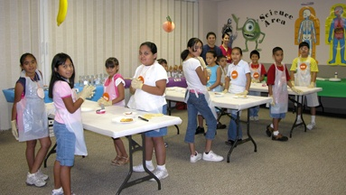
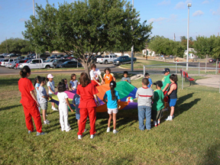
NutriFit Children’s Camp
Annual camp for children to learn nutrition and wellness.

Slide 16
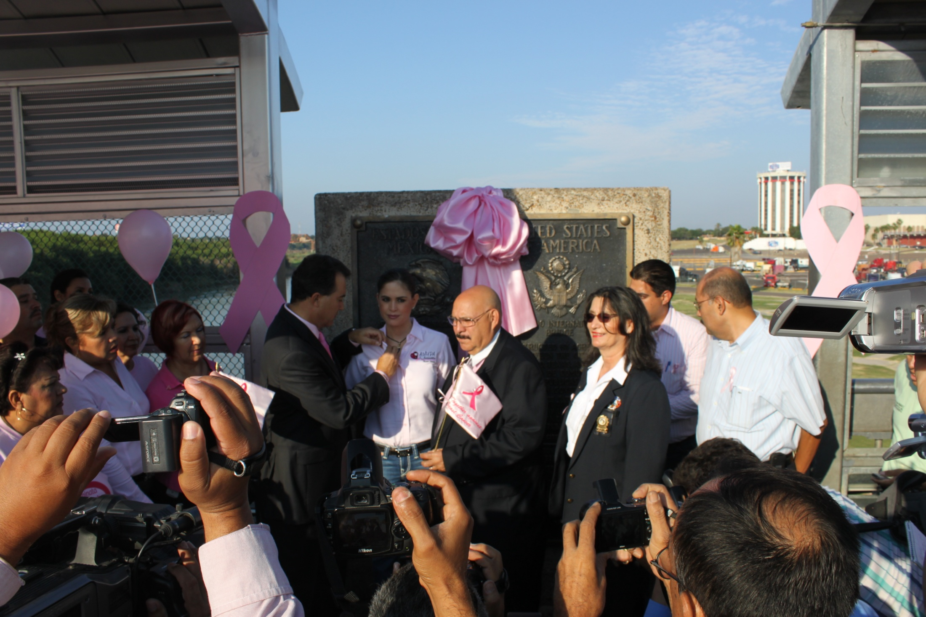
Bi-National Breast Cancer Awareness

Slide 17
US/Mexico Border New &
Emerging Challenges
Chronic disease (Diabetes, Cancer, Cardiovascular)
Emerging Diseases (MRSA, West Nile, XDR)
Environmental Health
Preparedness Response
Bi-National cooperation
Access to care

Slide 18
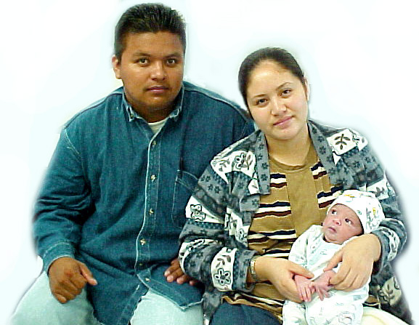

2600 Cedar Avenue
Laredo, Texas 78040
Phone: (956) 795-4900
Fax: (956) 726-2632
Hector F. Gonzalez, M.D., M.P.H.
Director of Health

