Slide 1
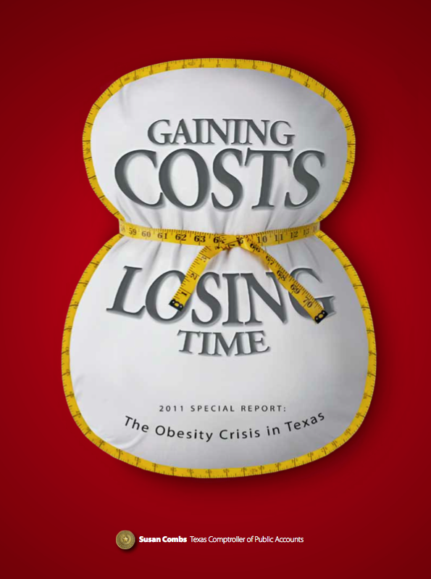
Gaining Costs, Losing Time: The Obesity Crisis in Texas
www.window.state.tx.us

Slide 2
Current Impact
The financial burden of obesity is a growing problem to our governments, private insurers and businesses
U.S. obesity costs were $147 billion in 2008, representing 9.1 percent of all U.S. health care costs

Slide 3
Attributable Costs to Private Insurers
Increased from 4.7 percent of total costs in 1998 to 12.9 percent in 2006
Obesity costs represent a significant burden to private insurers, and, by extension, businesses that provide insurance

Slide 4
Texas Business Costs Attributable to Obesity
Areas of Costs | Estimated Costs (2009) | Percent
Healthcare | $4,022,324,929 | 42.50%
Absenteeism | $1,643,955,363 | 17.40%
Presenteeism | $3,469,229,333 | 36.70%
Disability | $321,813,719 | 3.40%
Total Costs | $9,457,323,344
Source: Texas Comptroller of Public Accounts

Slide 5
Texas Business Costs Attributable to Obesity, 2009
Using this 12.9 percent share, the Comptroller estimated that direct health costs to Texas businesses due to obesity were more than $4 billion in 2009.
These direct and indirect costs to Texas businesses totaled $9.5 billion in 2009.

Slide 6
Total Projected Obesity Costs to Texas Businesses, 2009-2030 (in billions)

Slide 7
Projected Impact to Texas
We project that obesity costs to Texas businesses could reach $32.5 billion annually by 2030 if obesity rates continue as expected

Slide 8
Texas Comptroller Obesity Portal
The 82nd Texas Legislature tasked us to build an obesity web portal to help Texans address the economic effects of obesity
Map Fitnessgram data to identify areas with the highest risk of childhood obesity

Slide 9
Texas Comptroller Obesity Portal
Links to tools and websites related to health, wellness, treatment and prevention
Information on grants and funding
Fall 2012

Slide 10
Questions?
Michael Castellon
Texas Comptroller of Public Accounts
www.window.state.tx.us
@TxComptroller

