Slide 1
University of Health Our Health, Our Economy
Texas’ Budget Up in Smoke

Slide 2
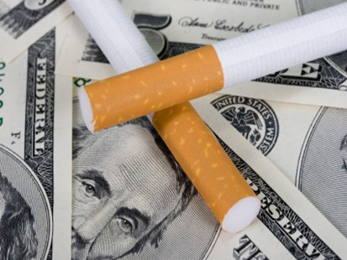

Slide 3
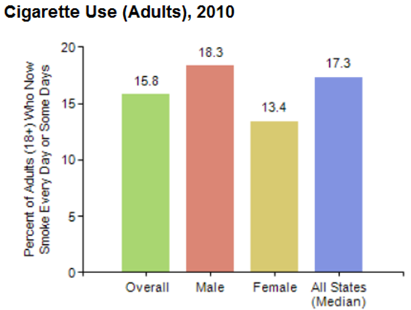
Smoking in Texas
Adults (2010)
Almost 16% - 2.9 million Texans - are smokers
Adult men are more likely to smoke than adult women
Notes:
Texas BRFSS and CDC BRFSS 2010

Slide 4
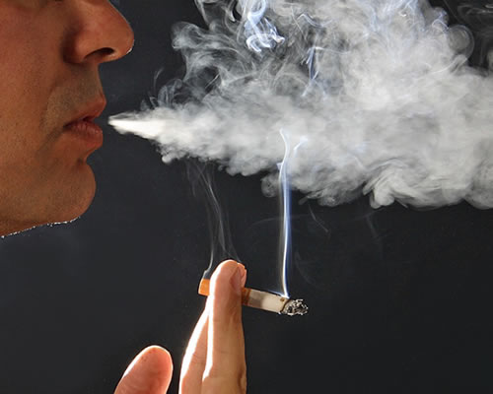

Slide 5
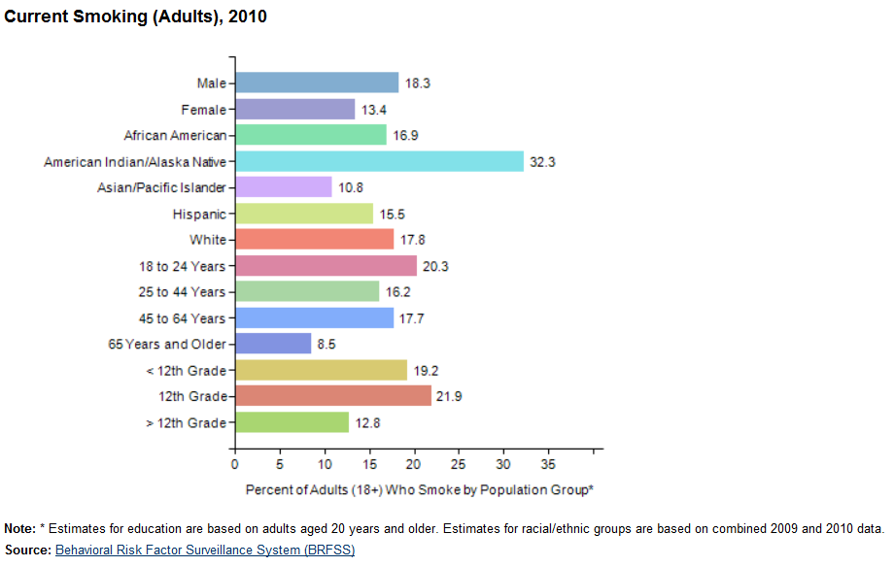
Smoking in Texas

Slide 6
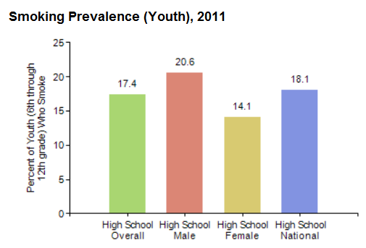
Smoking in Texas
Teens & adolescents (2011)
17.4% of Texas students in grades 6-12 are smokers
22.9% of middle & HS students surveyed used a tobacco product in the prior 30 days
8.5% smoke cigarettes daily
There are 29,100 new teen smokers each day
Notes:
Source: State data from Youth Risk Behavior Surveillance System (YRBSS), 2011; National data from National Youth Risk Behavior Survey (NYRBS), 2011

Slide 8
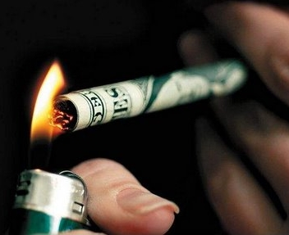
Financial burden of smoking in Texas
Medical costs related to smoking are more than $5.8 billion per year.
Smoking costs Texas $6.4 billion per year in lost productivity and lost death-related lifetime earnings.
In total, smoking is responsible for $12.2 billion in excess medical care expenditures and lost productivity in Texas.
Notes:
Texas Dept of State Health Services Jan 2011 Texans and Tobacco A Report to the 82nd Texas Legislature https://www.dshs.state.tx.us/WorkArea/linkit.aspx?LinkIdentifier=id&ItemID=8589952884

Slide 9
Health impact of smoking in Texas
In Texas, tobacco use is the single greatest preventable cause of premature death and disease.
Tobacco use is a major risk factor for multiple cancers, heart disease, stroke and lung disease.
24,000 adults per year die of a smoking-attributable illness in Texas.
That is more than die from AIDS, heroin, cocaine, alcohol, car accidents, fire and murder – combined.
For every one person who dies from tobacco-related causes, there are 20 more people who are suffering with at least one serious illness from smoking.
Notes:
http://texastobaccolaw.org/facts

Slide 10
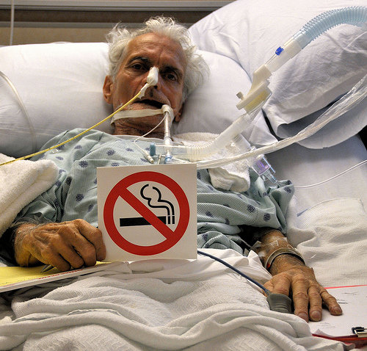

Slide 11
Texas tobacco prevention programs
School-based Prevention – Provides education for students in grades 4-12
Smokeless Tobacco Prevention – Targets youth throughout Texas via the Spit It Out Media and Outreach Campaign
Texas Youth Tobacco Awareness Program – Oversees court-ordered awareness training for minors cited for violating Texas tobacco laws.

Slide 12
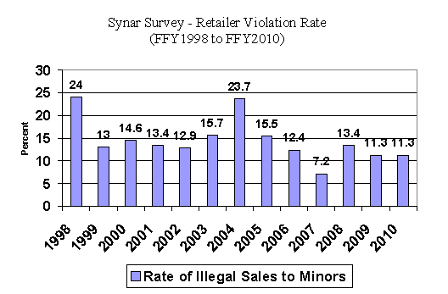
Texas tobacco prevention programs
Synar Survey - In Texas, the Comptroller’s office works with local law enforcement to enforce compliance with state tobacco laws. DSHS conducts the annual Synar Survey to determine the annual retailer violation rate.

Slide 13
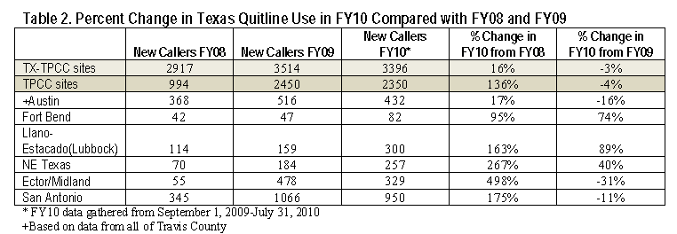
Tobacco Cessation Programs in Texas
DSHS Quitline Cessation Services - Provides telephone counseling, tobacco education, and limited nicotine replacement therapy to Texas residents.
The number of Quitline callers has risen from 3,000 Texans in 2008 to 14,222 in 2010.

Slide 14
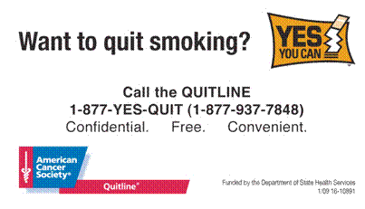

Slide 15
Tobacco Cessation Programs in Texas
TPCC Cessation Activities – “Tobacco Prevention and Control Coalitions” educate the public and engage healthcare providers in promoting smoking cessation.
Coalitions consulted with 1,674 healthcare providers in 2010.
The Yes You Can! Cessation Tool Kit promotes changes in clinical practice on tobacco assessment and referrals to counseling and resources.

Slide 16
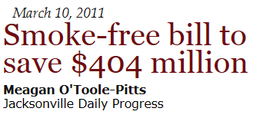
Smoke-free Texas

Slide 17
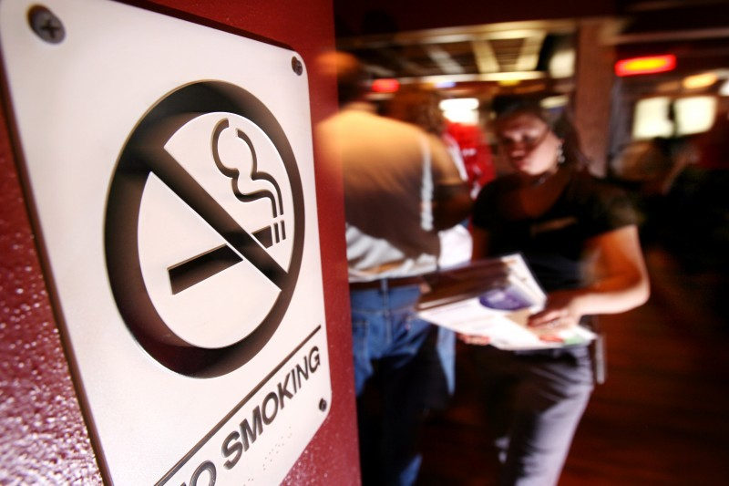

Slide 18
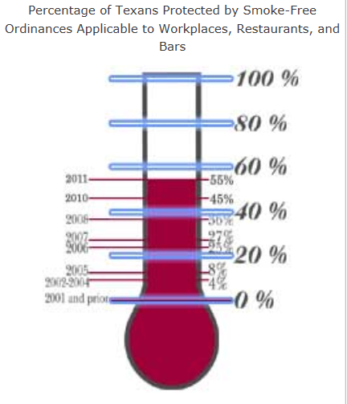
Smoke-free Texas
In Texas, 36 cities
– 55% of Texans – are covered by comprehensive smoke-free indoor workplace ordinances
29 states have already passed comprehensive statewide smoking bans
Notes:
http://www.dshs.state.tx.us/tobacco/smokefree.shtm

Slide 19
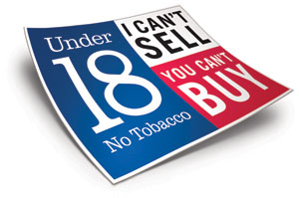
Other Texas public health policies on tobacco
Prohibition on sales to minors including specially designed warning signs
Tobacco Taxes
State employee health plan coverage for smoking cessation
Medicaid coverage of smoking cessation

Slide 20
Tobacco related resources
FDA, Tobacco Products Scientific Advisory Committee: www.fda.gov/AdvisoryCommittees/CommitteesMeetingMaterials/TobaccoProductsScientificAdvisoryCommittee/default.htm
Centers for Disease Control and Prevention: http://www.cdc.gov/tobacco/
U.S. Surgeon General’s Report: http://www.cdc.gov/tobacco/data_statistics/sgr/2012/index.htm
American Cancer Society, The Great American Smokeout: www.cancer.org/healthy/stayawayfromtobacco/greatamericansmokeout/
American Heart Association: www.heart.org/HEARTORG/Advocate/IssuesandCampaigns/Prevention/Reducing-Tobacco-Related-Deaths-through-advocacy_UCM_311388_Article.jsp
American Lung Association: http://www.lung.org/stop-smoking/
Smoke-Free Texas: http://smokefreetexas.org/
Texas Medical Association: http://www.texmed.org/template.aspx?id=7278
Texas Department of State Health Services: https://www.dshs.state.tx.us/tobacco/
Tobaccofreekids.org; KillTheCan.org; garbagePailKids; Don’t Dip;

